Slide 1
Insemi TimeSheet
SubRoutines and diagrams

Slide 2
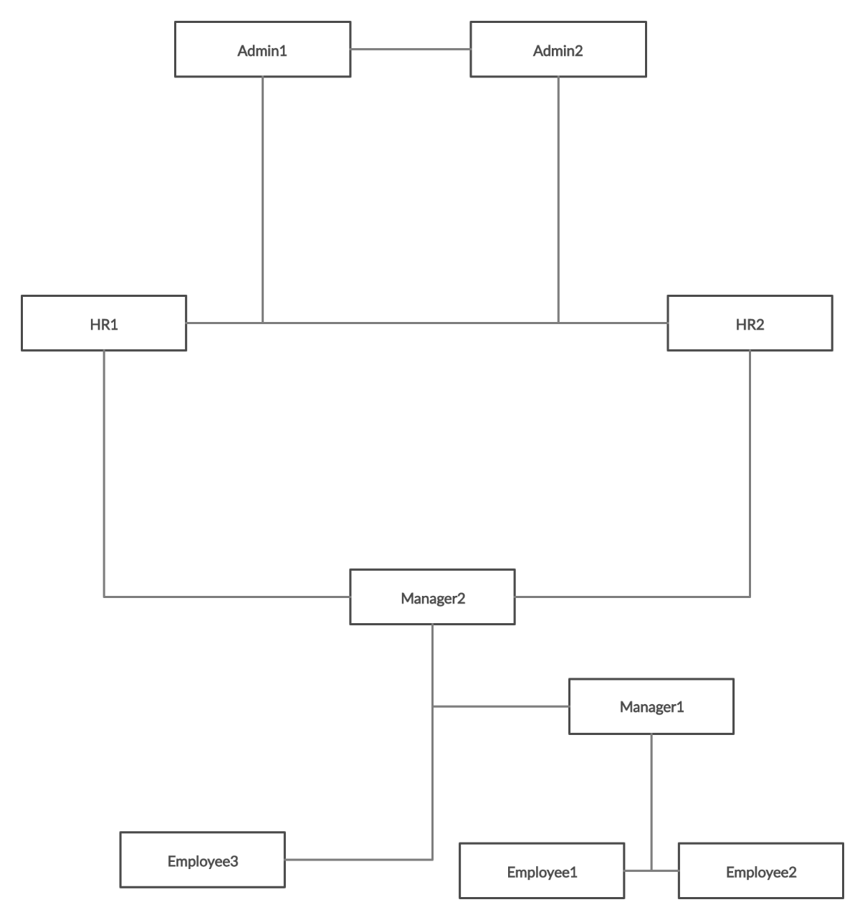
Hierarchy of Users

Slide 3
Subroutine 1 - Login
Logout Previous User (if any)
CSV
SQL
Login New User

Slide 4
Subroutine 2 – Admin Function 1: Create User
Create User
Username (E-mail)
Password
Confirm Password
First Name
Last Name
CSV
SQL

Slide 5
Subroutine 3 – Admin Function 2: Delete User
CSV
SQL
Delete User

Slide 6
TimeSheet

Slide 7
Subroutine 4 – View TimeSheet
UI
(Calendar-Based)
Date Range
CSV
SQL
Search (User)
Search by Leave Type

Slide 8
Subroutine 5 – Log TimeSheet
UI
(Calendar-Based)
Log each day
CSV
SQL
Mark Leaves
Multiple Projects

